Slide 1
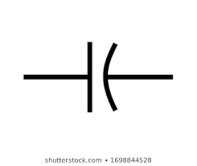
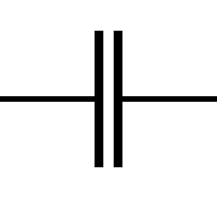
CAPACITORS
PHYSICS PROJECT
MEMBERS:
Muhammad Zunique
Ammar Siddiqui
Mauz Zaffar

Slide 2
CONTENTS:
Charge
Electric Field
Electric Flux & Intensity
Guass’s Law
CAPACITORS
Defining
Capacitance and its factors
Caps network

Slide 3
ELECTRIC CHARGE:
Symbol: Q or q
Nature: Scalar
Unit: Coulumb (C)
Dimension: [ IT ]
Definition:
“The electric force of matter due to which it experiences force in an EM field.”
OR
“Electric charge is due to loss or gain of electron(s).”
IMPORTANT POINT:
* Parental Quantity.

Slide 4
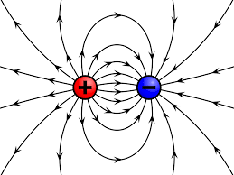
TYPES
+ve
*deffeciency of electron.
*HOLE
-ve
*unbalanced electron.

Slide 5
ELECTRIC FIELD AND FIELD INTENSITY:
“ Electric field is defined as the electric force per unit charge. The direction of the field is taken to be the direction of the force it would exert on a positive test charge. The electric field is radially outward from a positive charge and radially in toward a negative point charge. ”
ELECTRIC FIELD INTENSITY( E )
“ The electrostatic force experienced by a point test charge due to a point source charge at some distance away in an electric supported medium. ”
Explanation:
A/c to Coulomb’s law ;
E.F = KQq/r*r
Or

Slide 6
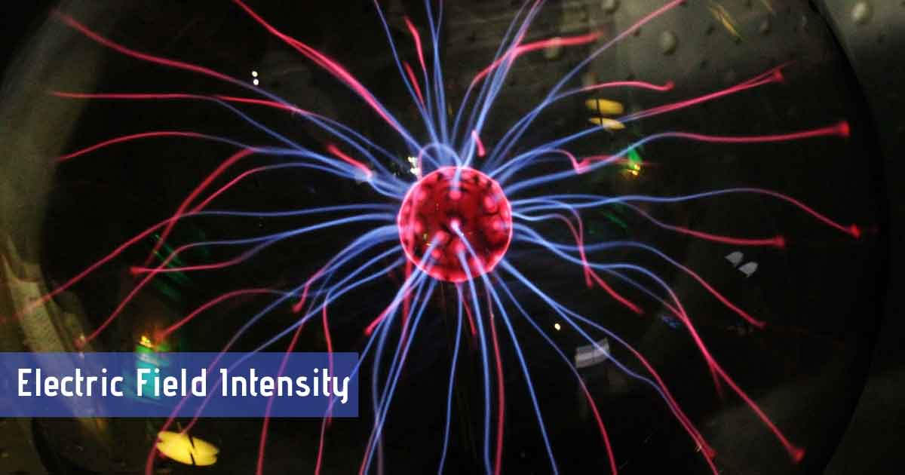
=> E = E.F/q = KQ/r*r
In terms of vectors,
E = E.F/q = KQ/r*r( r )
UNIT :
N/C or V\m

Slide 7
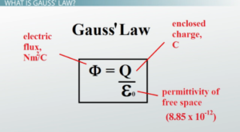
GUASS’S LAW:
Total flux passing through hypothetical surface is total charge passing through particular area by permitivity of that medium.
NOTE THAT:
* Electric flux is dot product of field intensity and vector area.
* Electric flux / vector area = Electric flux density

Slide 8
CAPACITOR OR CONDENSOR:
Capacitors are categorized on the basis of type electric current passed through its plates:
AC
*Filter.
DC
*charge storing device.
“ Capacitor is an electrical device that is used to induce electric fields between its plates. ”
OR
“ Capacitor is a charge storing device. ”
OR
“ Capacitor is an energy storing device. ”

Slide 9
CAPACITANCE OF A CAPACITOR:
Q ∝ V
=> Q=(constant)V
=> Q=CV
Where, C is capacitance of a capacitor.
WHAT IS CAPACITANCE??
Charge stored on one single plate per unit P.D
i.e
C=Q / V
And unit of capacitance is ‘ FARAD’.

Slide 10
Capacitance of Parallel plate Capacitor:
The capacitance is given by,
=> C = Q/V ------eq.1 where, V= potential differnce & Q= charge
while, “V” b/w plates is,
=> V = E.d------eq.2
By Guass’s law ,
=> E = σ/ε , where ; σ = Q/A ε = permitvity of medium
So,
=> E = Q/ A. ε
Equation 2 will be,
=> V = Q.d/A. ε
By subsituting , eq.1 will be as,
=> C = A. ε / d

Slide 11
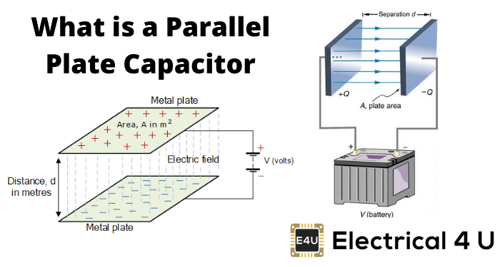
Factors Affecting Capacitance of Capacitor:
Following are the factors that affect capacitance of a capacitor:
Distance between plates.
Area of plates.
Di-electric b/w plates.
If we put a di-electric b/w plates of capacitor , the capacitance will increase as compare to capacitance of free space.

Slide 12
Charging of Capacitor:
During charging of capacitor , one plate receive charge directly from battery & second plate recieves charge due to electrostatic induction.
Charge stored by one plate is directly proportional to potential differnce.
i.e q ∝ V
=> q = CV
CAPS NETWORK:
Capacitors are combined in two types:
PARALLEL COMBINATION
SERIES COMBINATION

Slide 13
PARALLEL :
P.D remains same due to common terminal.
Q = Q1+Q2+Q3+…+Qn
due to multiple paths.
Ceq = C1+C2+C3+…+Cn
For n-identical capacitors;
Cn = n.C
SERIES:
P.D varies due to no common terminal.
V = V1+V2+V3+…+Vn …, due to same path.
1/Ceq = 1/C1 + 1/C2 +…+1/Cn
For n-identical capacitors;
Cn = C / n

Slide 14
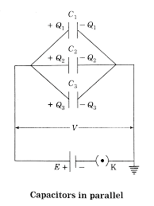
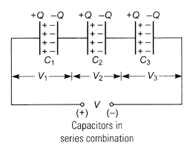
THANK YOU…..!

